Slide 1
GLACIAL LANDFORMS
BY
DR. GULSHAN RASHID
ASSISTANT PROFESSOR
IN
GEOGRAPHY

Slide 3
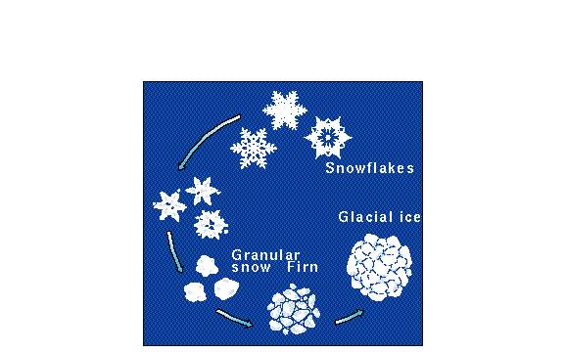
Origin of ice

Slide 5
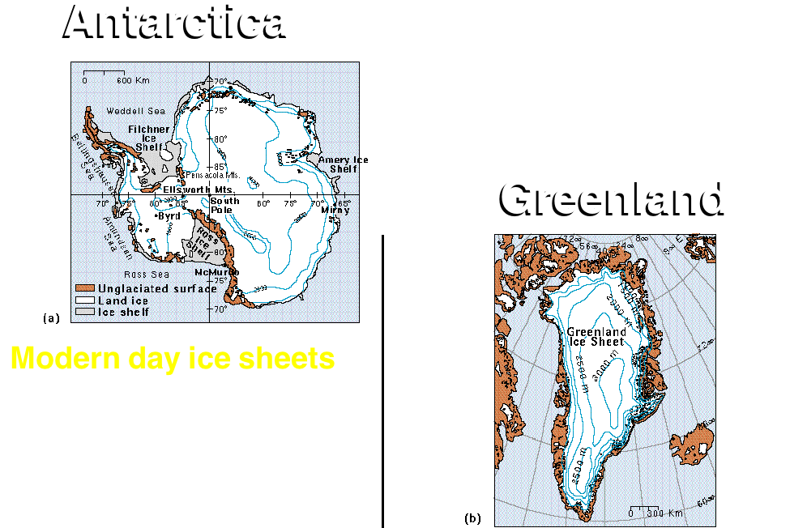

Slide 6
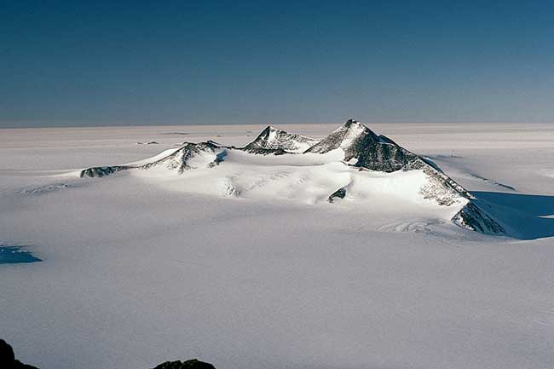
Continental Glaciers
Continental ice sheets cannot gain much sediment from mass wasting - little is exposed
Polar ice sheets are mostly devoid of sediment except windblown dust from lower latitudes, except near their bases

Slide 7
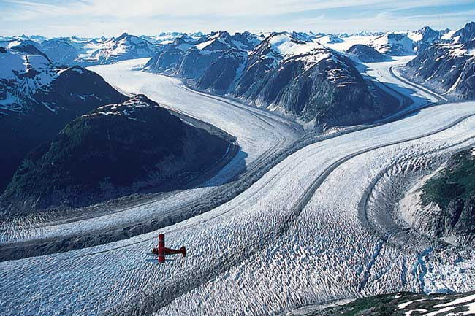
Alpine Glaciers
Valley glaciers get most of sediment loads from
mass wasting and intense weathering of adjacent slopes
Rock debris of lateral and medial moraines stays high up
Tongas National Forest, Alaska

Slide 8
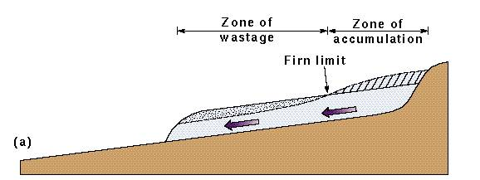
Response of a Glacier to Changes in Glacial Budget

Slide 9
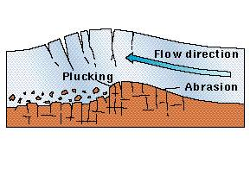
Erosional Processes
Erosional Processes
･
･
Important erosional
Important erosional
processes associated
processes associated
with glaciers include
with glaciers include
plucking, abrasion, and
plucking, abrasion, and
bulldozing.
bulldozing.
･
Plucking and abrasion
･
Plucking and abrasion
are most common
are most common
>
can form a landform
>
can form a landform
called a roche
called a roche
moutonnee
moutonnee

Slide 10
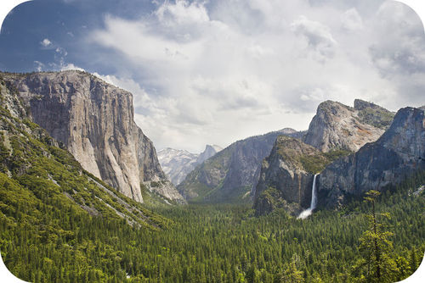
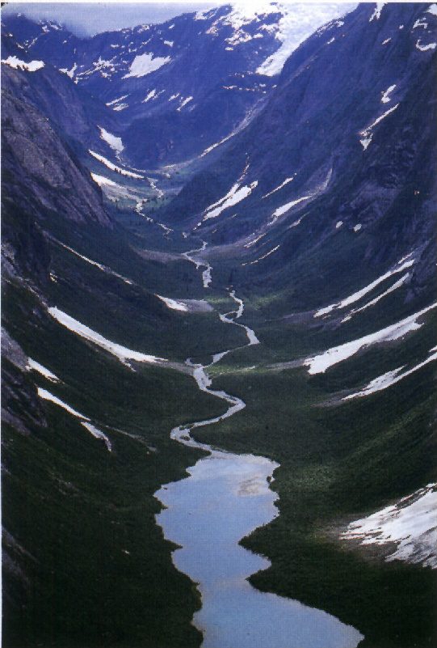
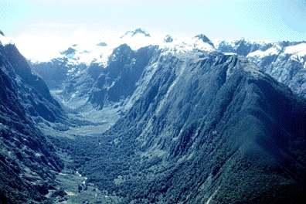
U-shaped valley

Slide 11
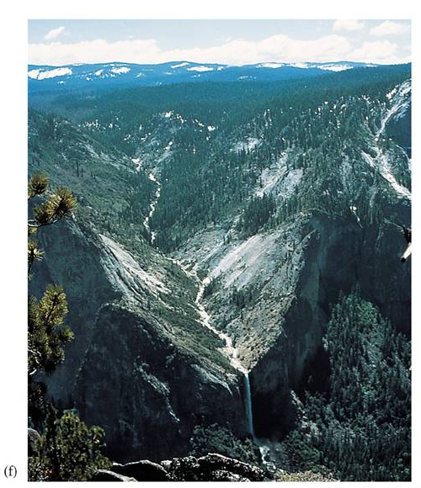
Hanging valley

Slide 12
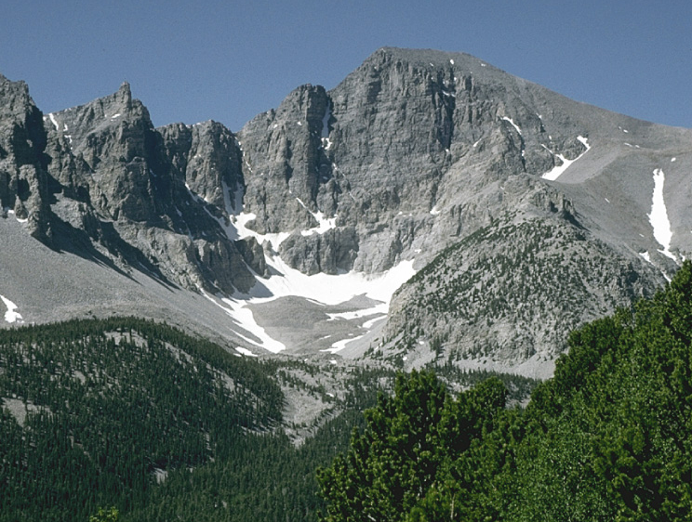
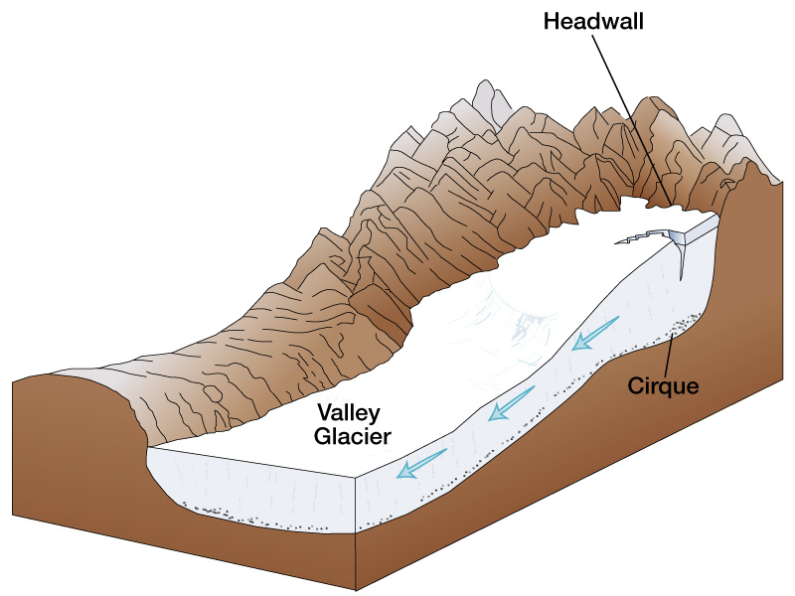
CIRQUE

Slide 13
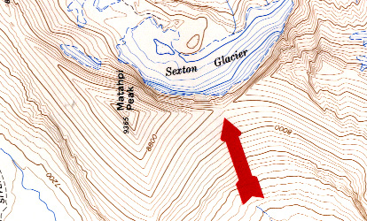
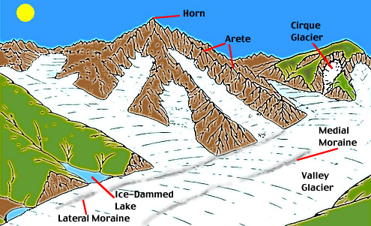
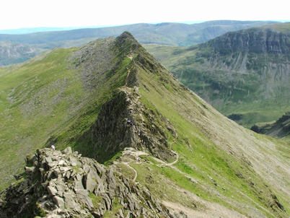
Arete

Slide 14
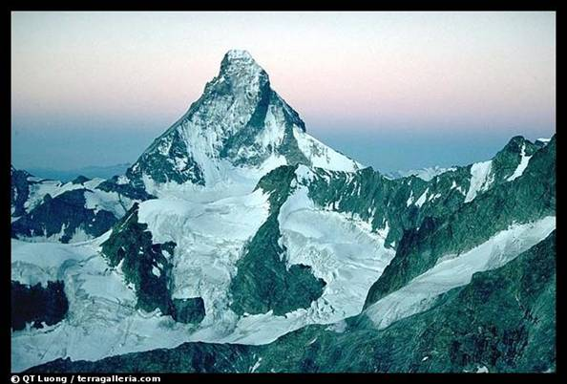
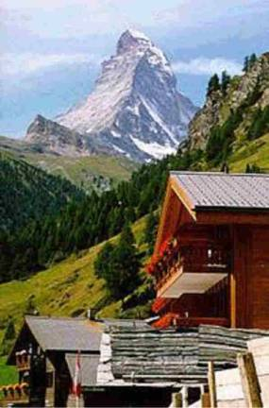
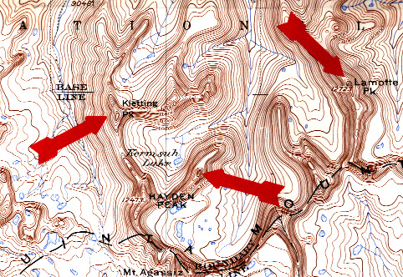
Horn

Slide 15
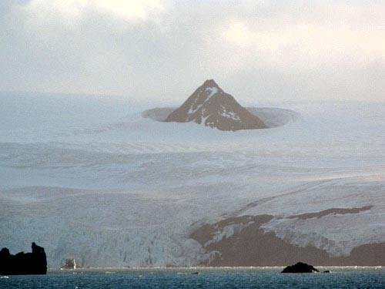
NUNATAK

Slide 16
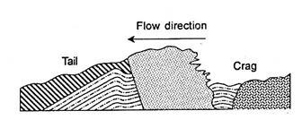
CRAG AND TAIL

Slide 17
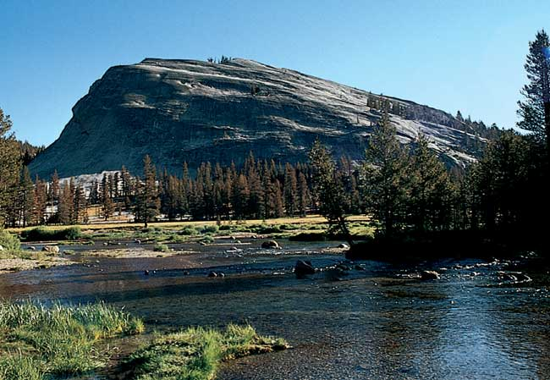
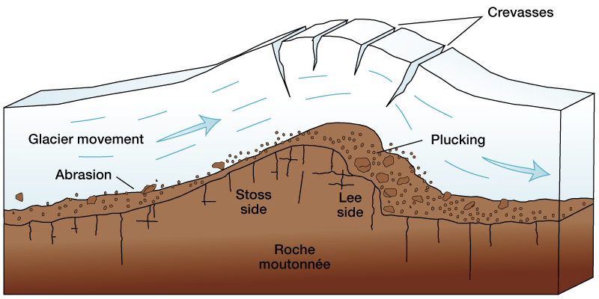
Glacial Erosion – Roche Moutonée

Slide 18
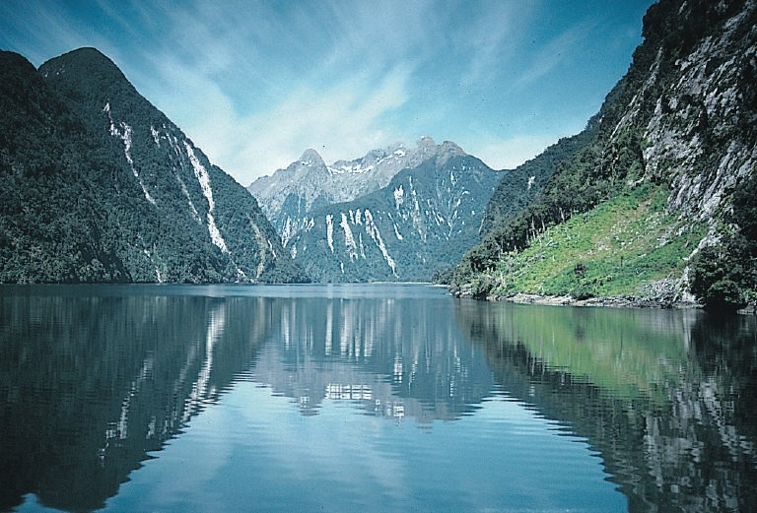
Seawater Flooded U-Shaped Valleys: Fiords =Fjords
When glaciers melt, sea-level rises

Slide 19
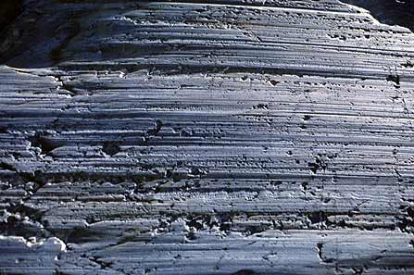
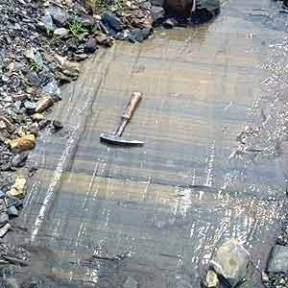
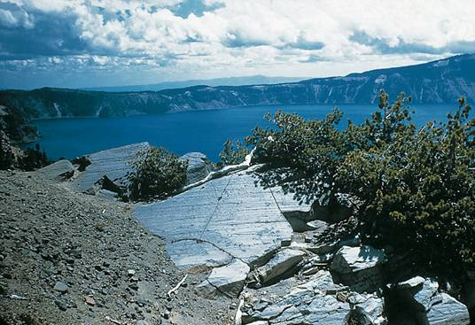
Glacial Erosion
Glacial Striations and
grooves

Slide 20
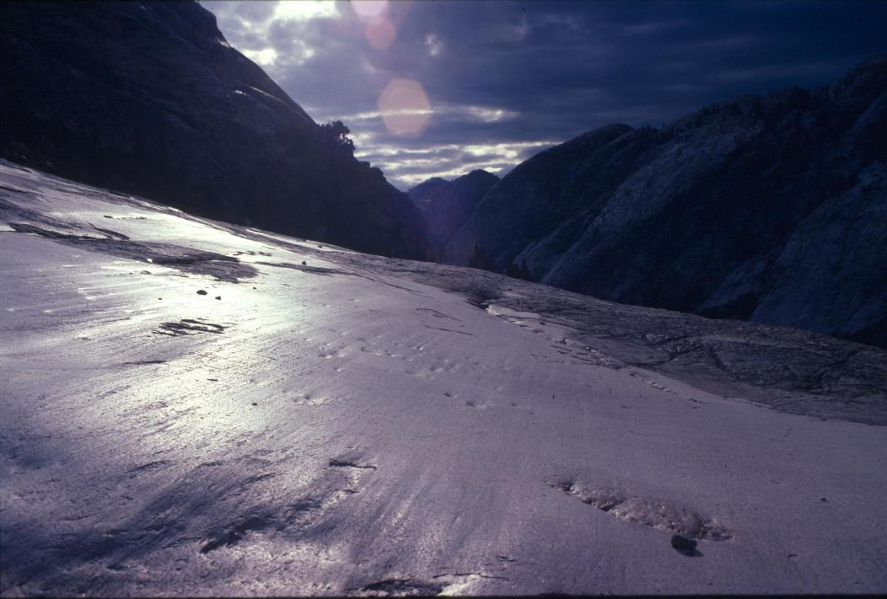
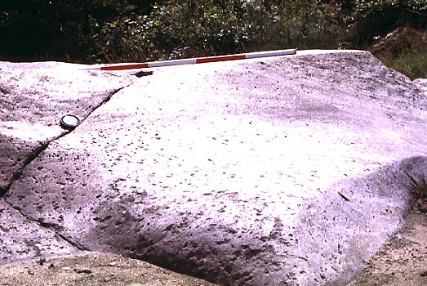
Glacial Polish

Slide 21
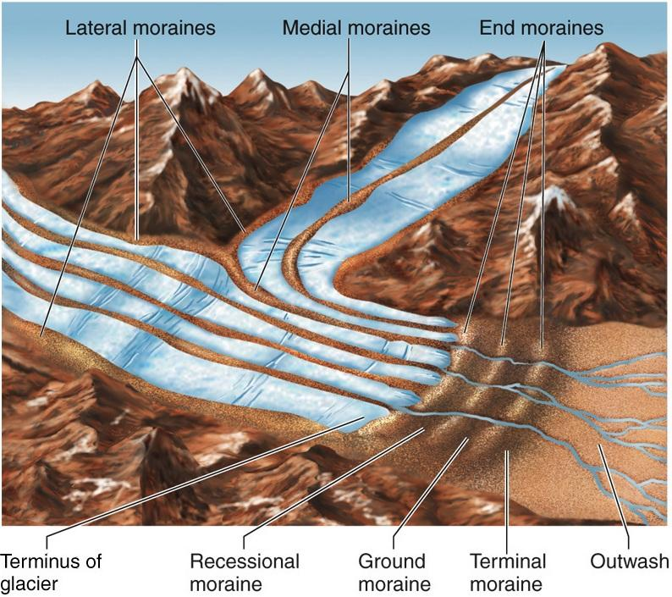
MORAINES

Slide 22
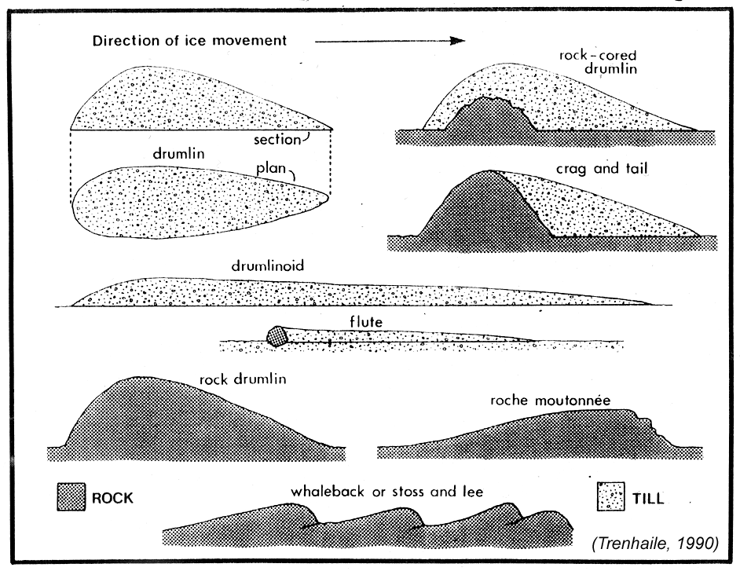

Slide 23
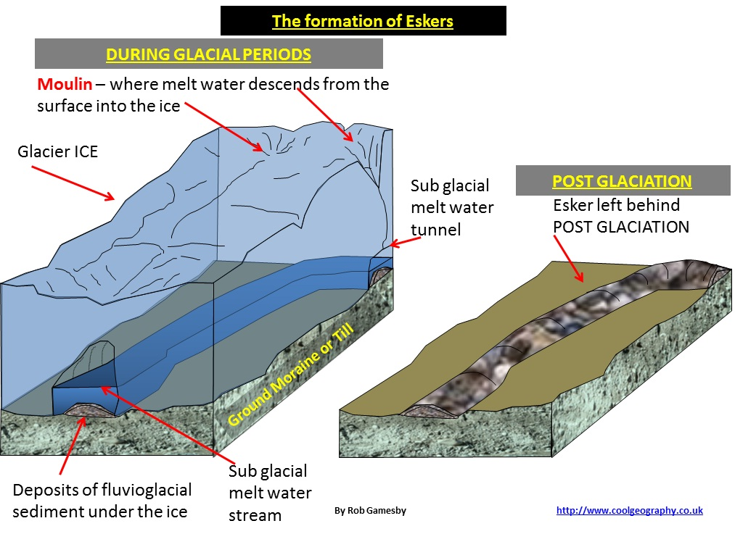
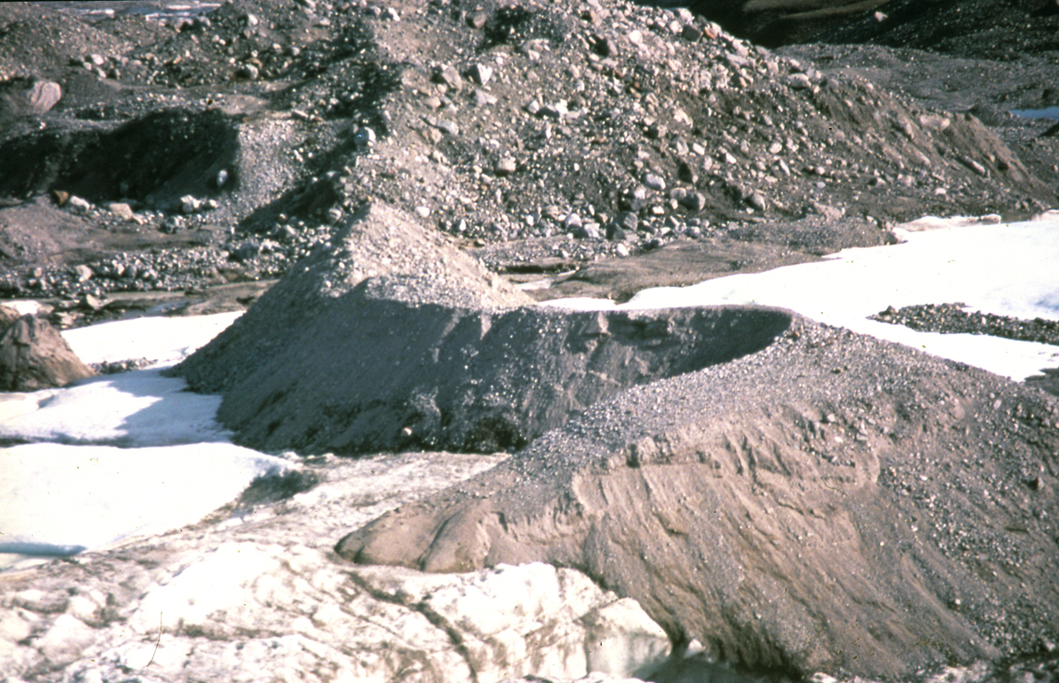
ESKERS

Slide 24
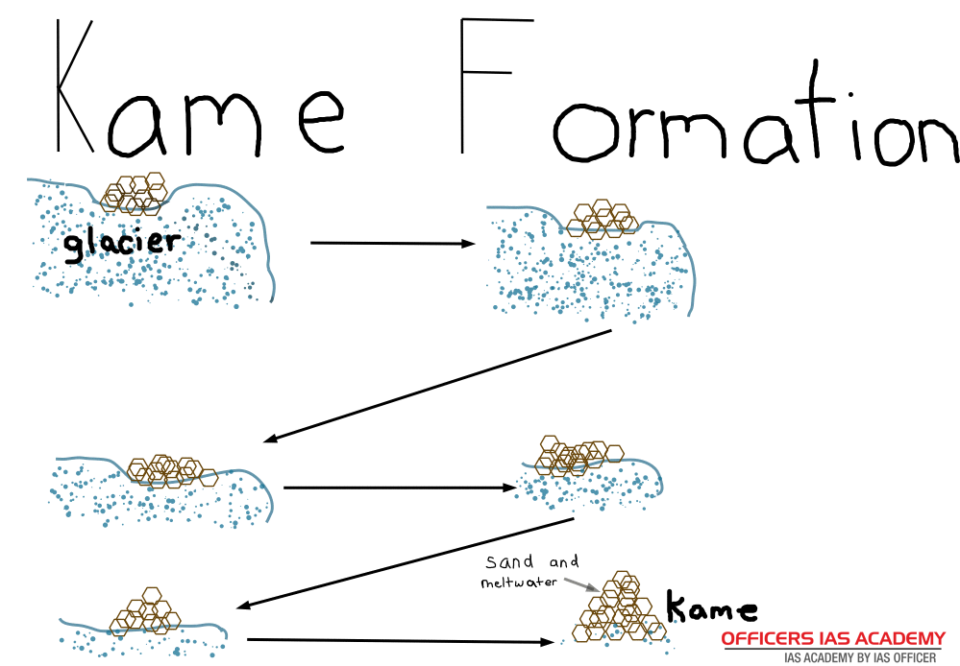
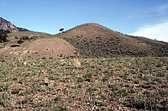
KAME

Slide 25
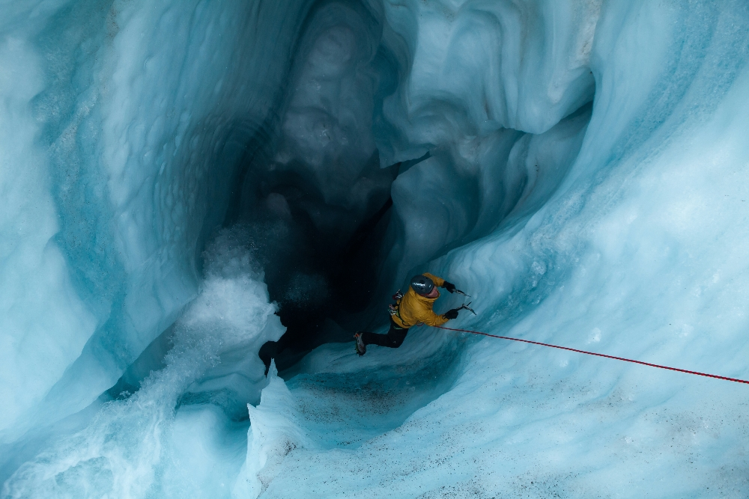
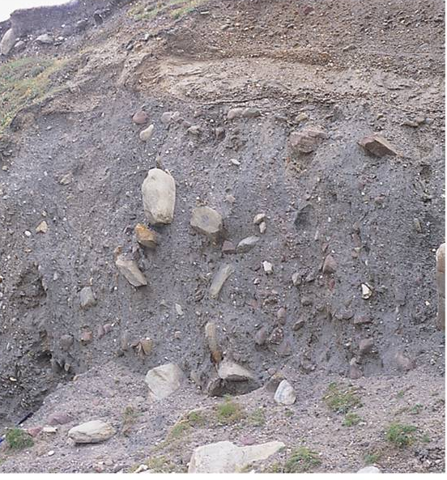
MOULIN
Glacial Till

Slide 26
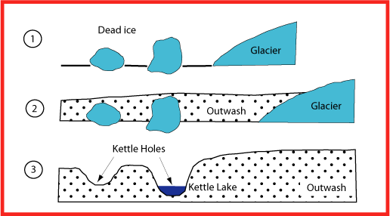
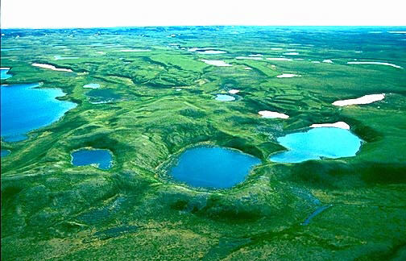
KETTLE HOLES

Slide 27
THANKS

